Slide 1
CS171 FINAL PROJECT
Created by:
Luke Reardon and Hillel Zweig
Friday December 13, 2013

Slide 2
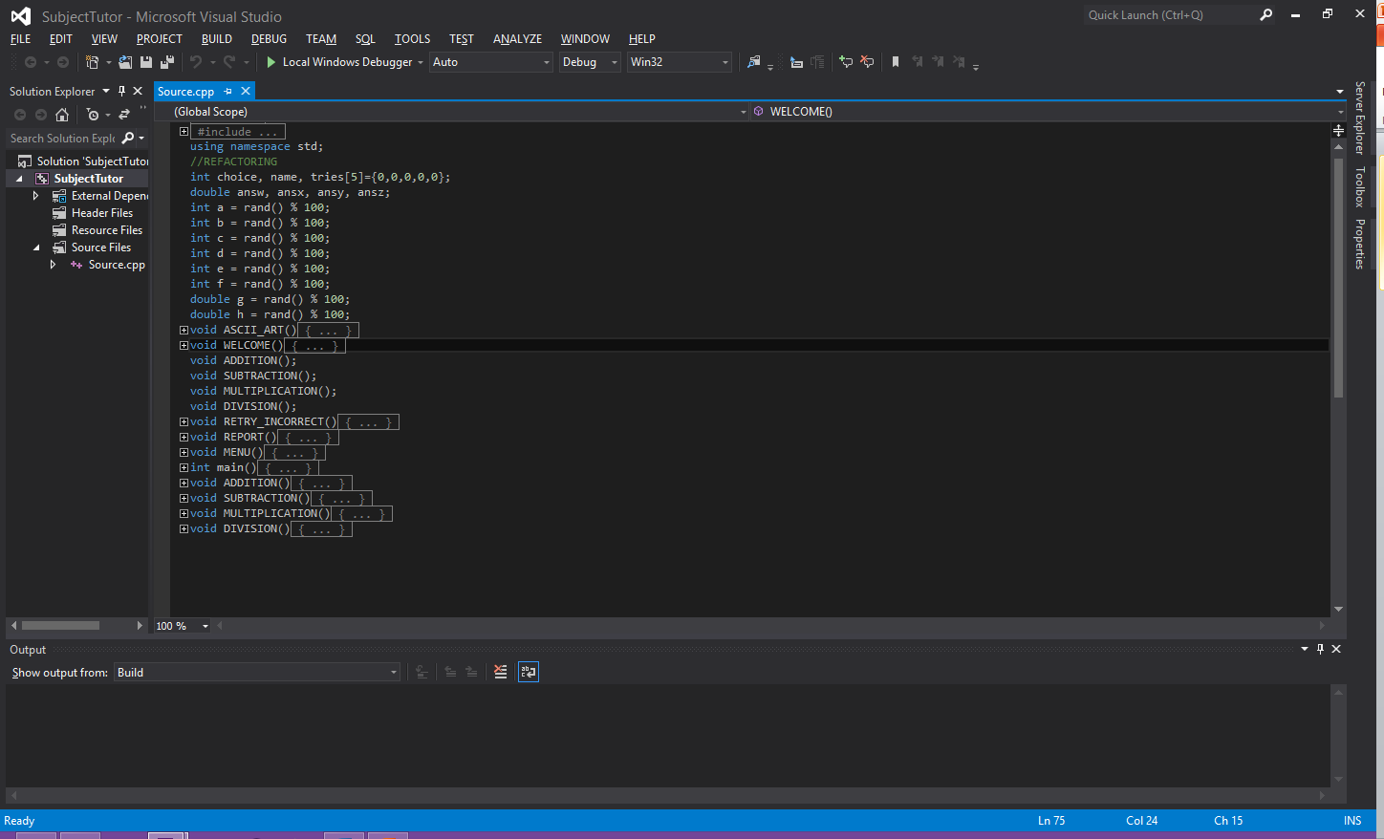
Semester project
SubjectTutor program only had basic arithmetic problems

Slide 3
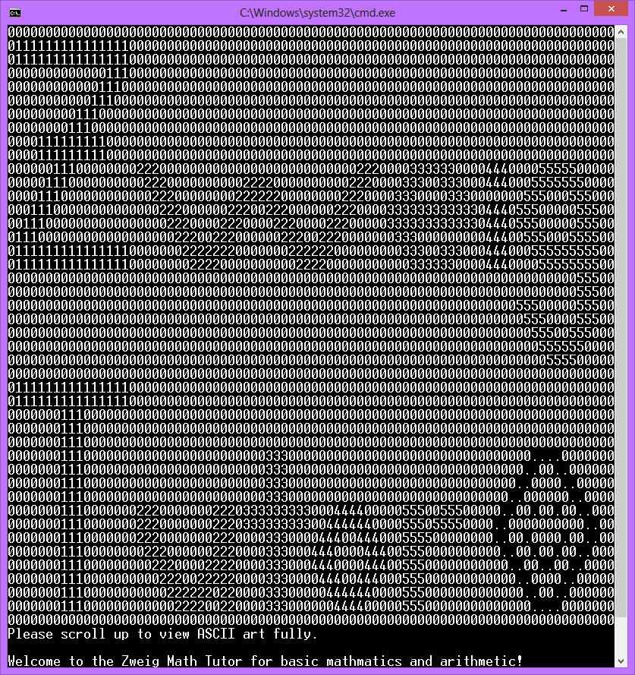
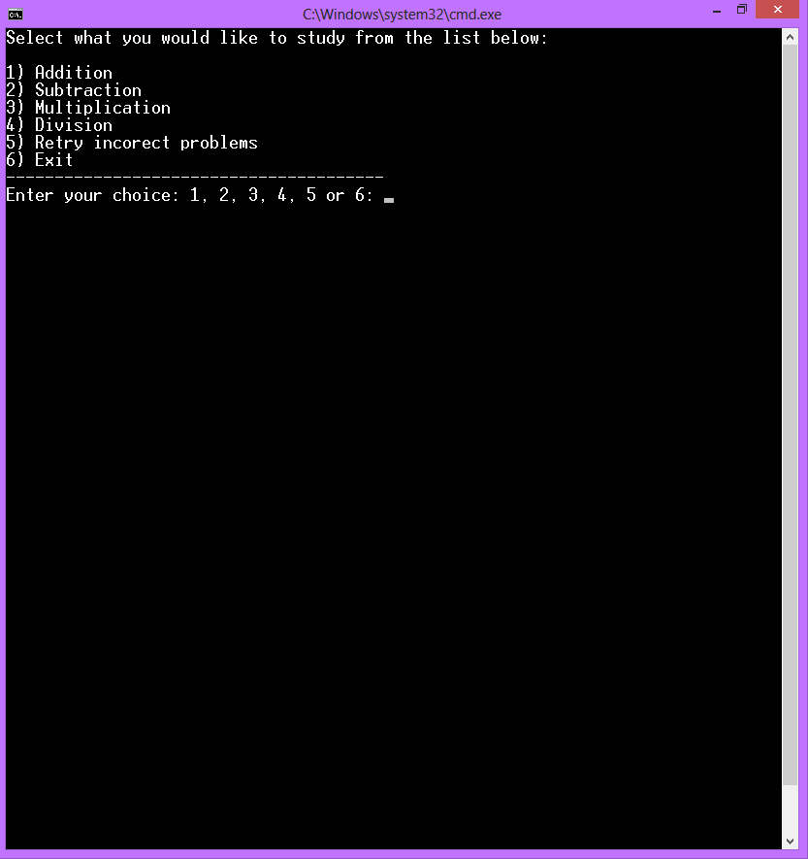
Semester project
SubjectTutor program maybe had ASCII art or other attention getting design and only had basic arithmetic menu and problems

Slide 4
Our format
Main menu
Arithmetic
Addition
Subtraction
Multiplication
Division
Perimeters
Circle
Triangle
Square
Rectangle
Pentagon
Hexagon
Octagon
Area
Circle
Triangle
Square
Rectangle
Trapezoid
Parallelogram
Volume
Sphere
Cylinder
Cube
Regular triangular prisms
Regular rectangular prisms
Cones
Report/Retry functions
Report correct and incorrect totals, including ratio/percentage.
Retry problems within subjects where errors were made, allowing user to gain more practice in a difficult subject.
Report new progress and repeat if necessary.

Slide 5
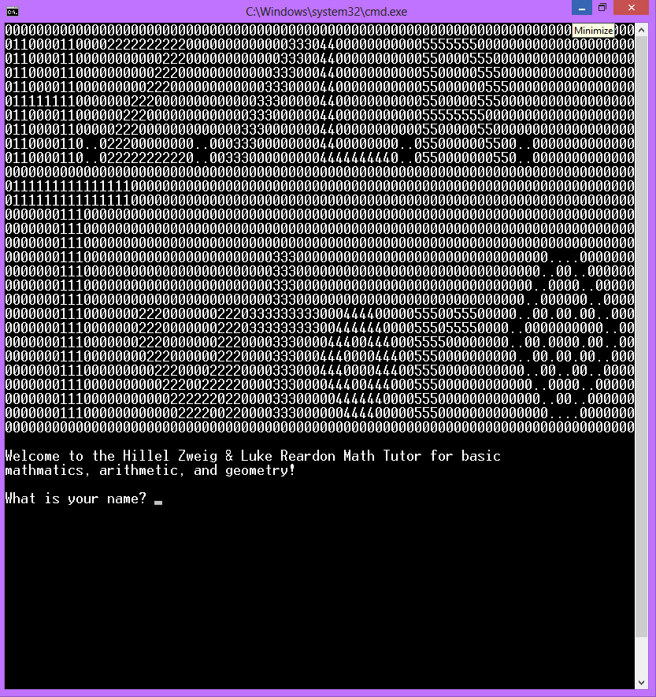
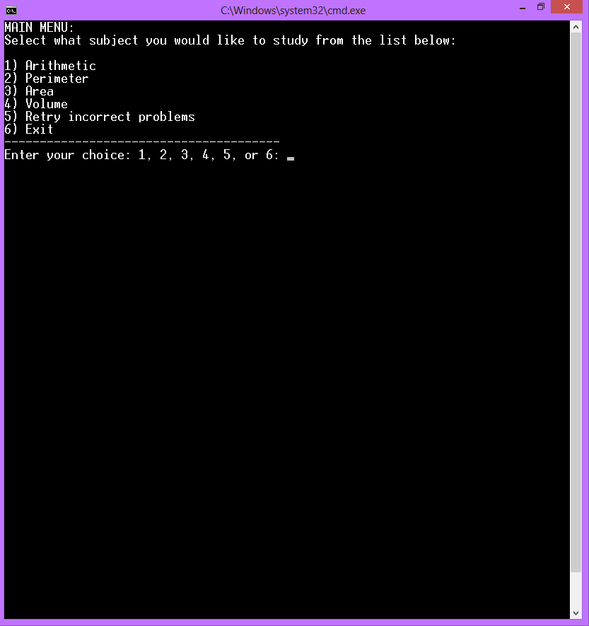
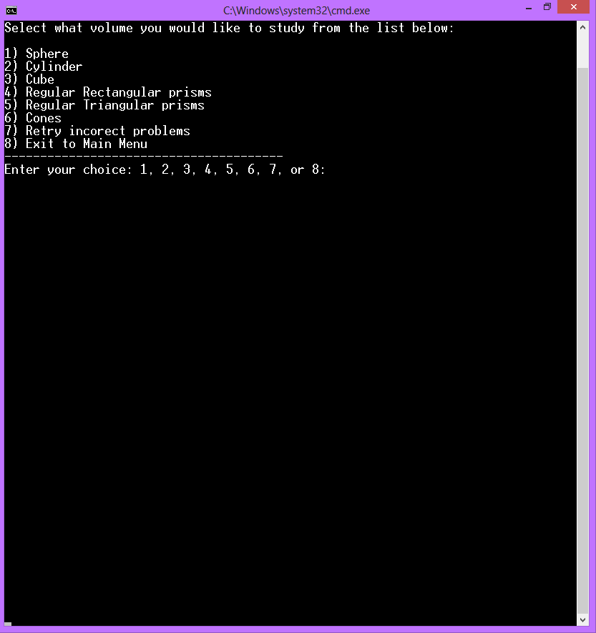
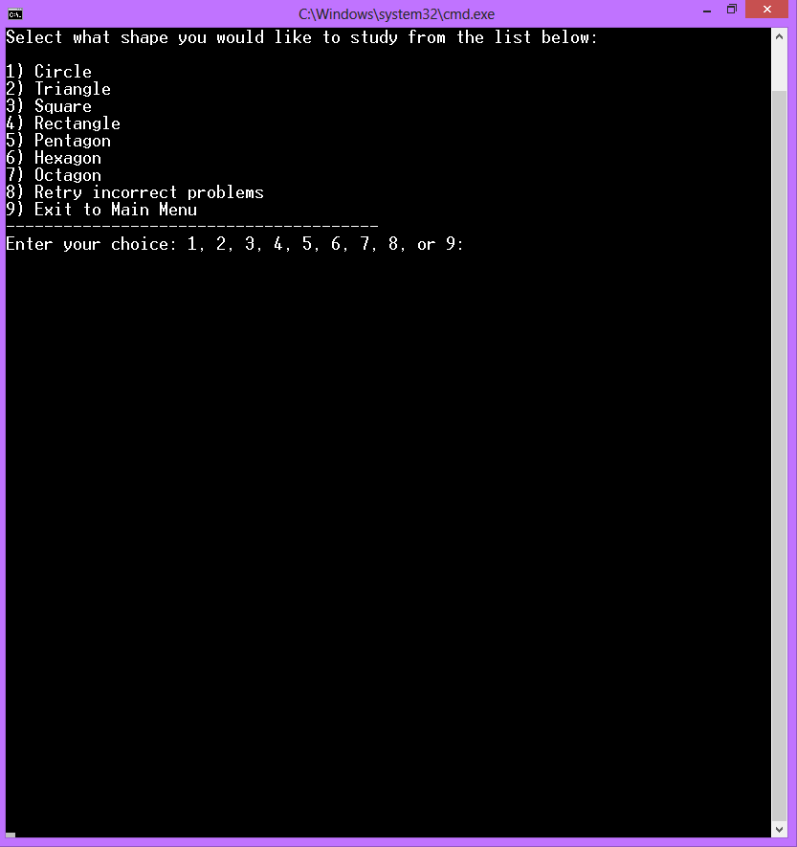
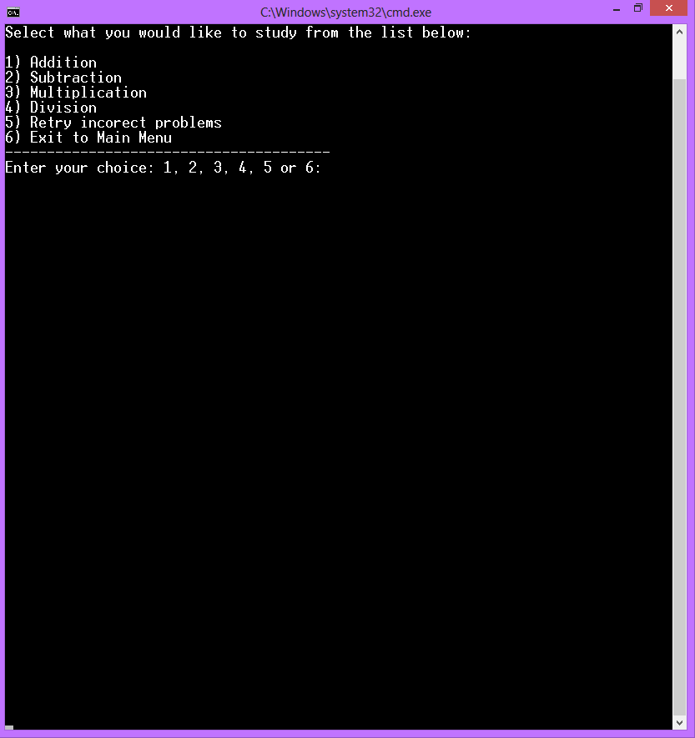
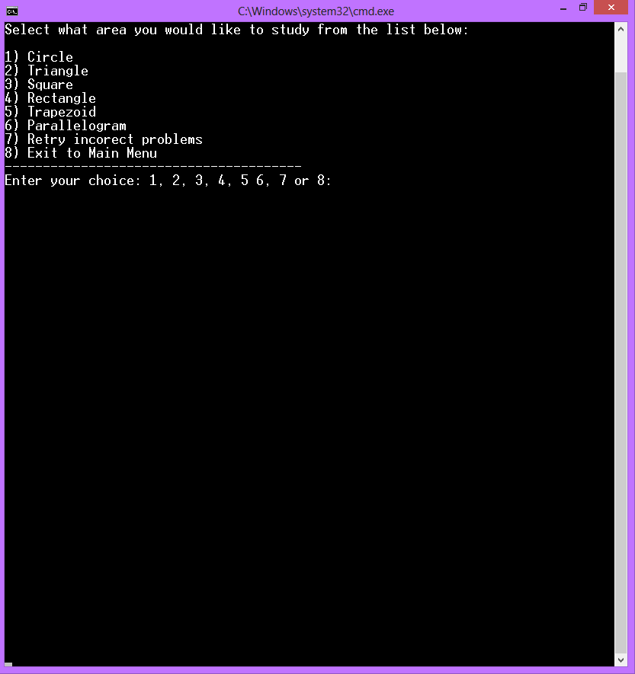
Our project: SubjectTutor expansion
Main Menu
Arithmetic menu
Perimeter menu
Area menu
Volume menu

Slide 6
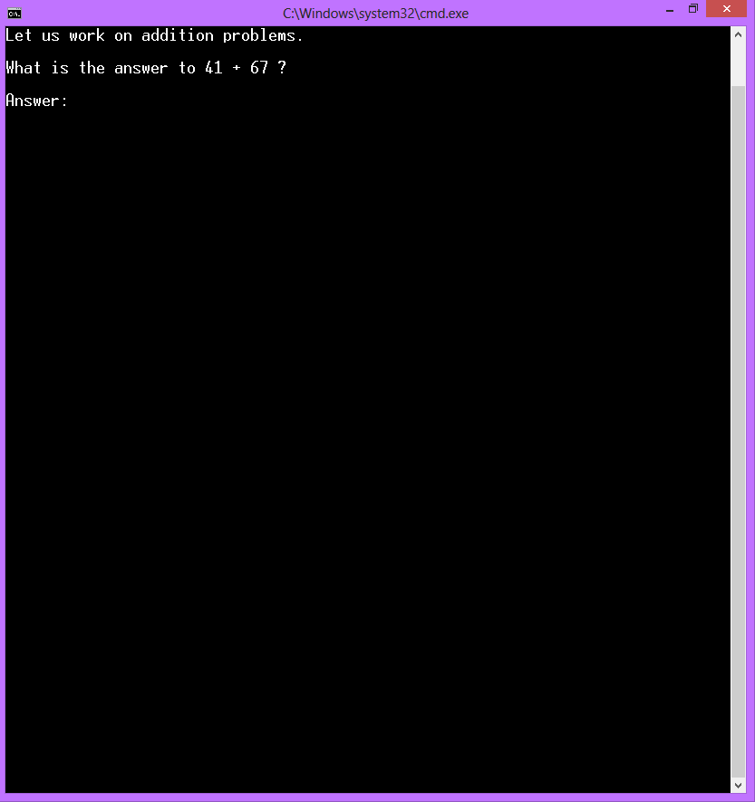
Sample arithmetic problem

Slide 7
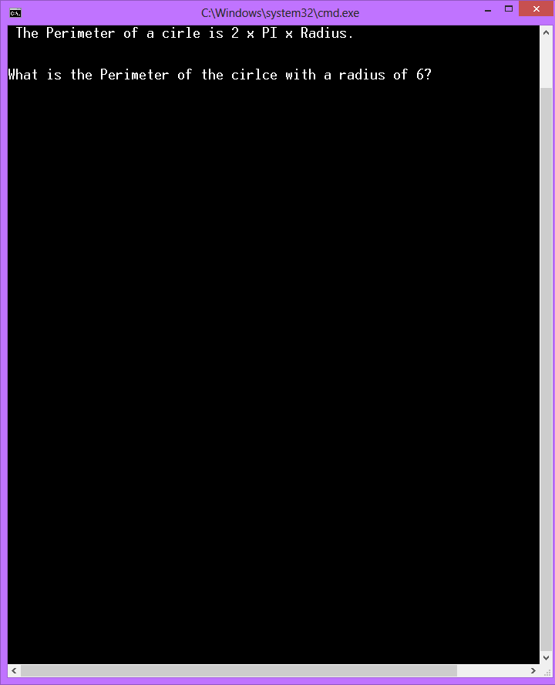
Sample perimeter problem

Slide 8
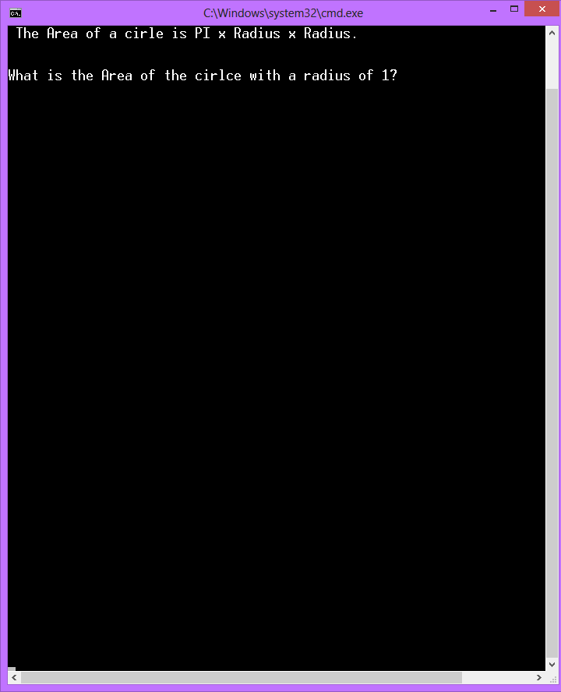
Sample area problem

Slide 9

Sample volume problem

Slide 10
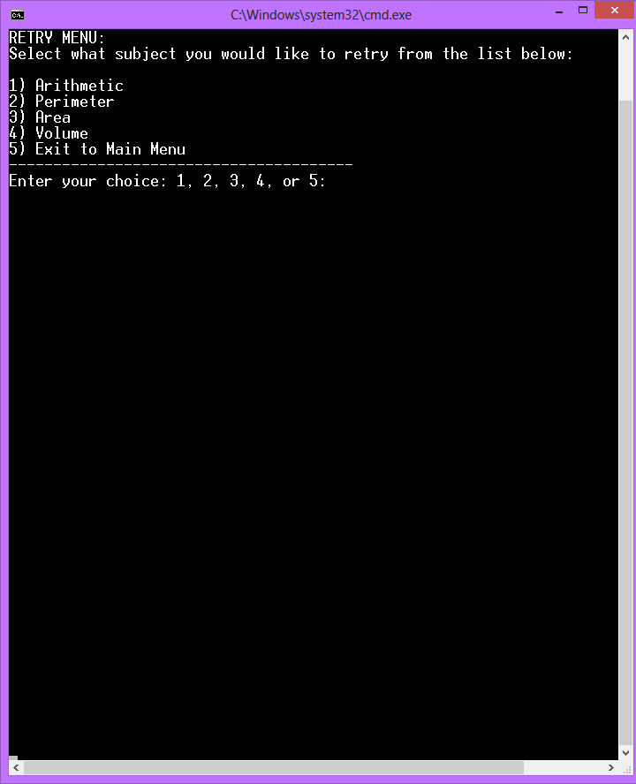
Retry Menu

